Slide 1
The Path Forward - Venous and Lymphatic Medicine Subspecialty Reason, History, and Progress Zoe Deol, MD

Slide 2
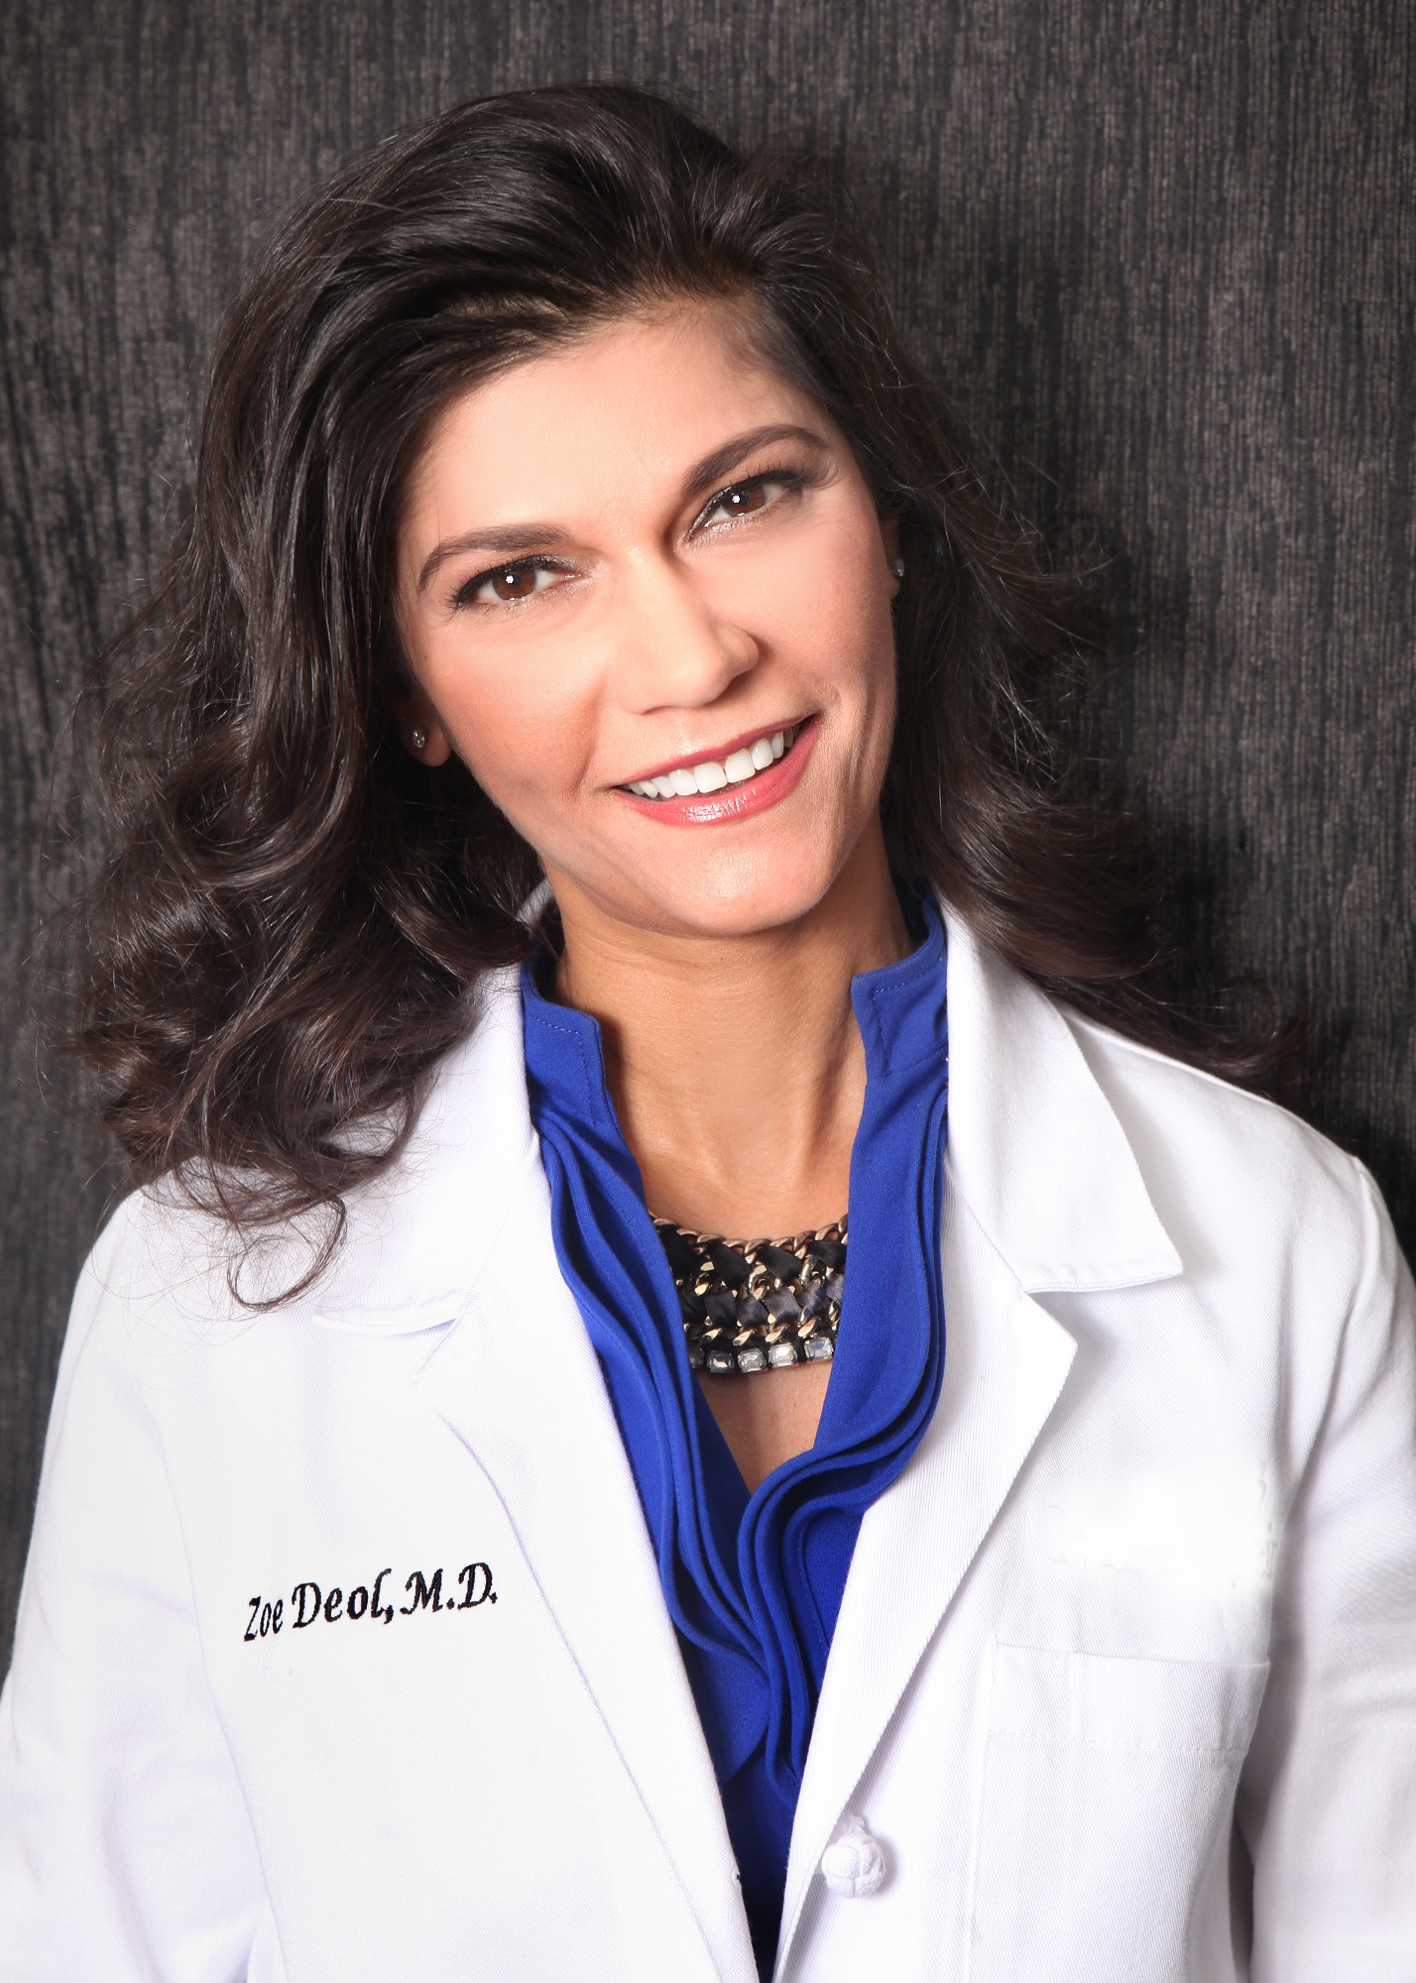
Zoe Deol, MD, FACS, DABVLM Credentials and Disclosures
Board certified General Surgeon, Bariatric Surgeon and certified by American Board of Venous and Lymphatic Medicine
Regional Medical Director for Center for Vein Restoration and Center for Vascular Medicine in SE Michigan and Ohio
Clinical Assistant Professor at Michigan State University College of Human Medicine Department of Surgery
On Advisory Board for Tactile Medical

Slide 4
Current VLM Patient
General
Anesthesiology
Vascular
Surgery
Dermatology
Plastics
Emergency
Medicine
OB-GYN
Vascular Medicine
Internal Medicine
Radiology
Interventional
Radiology
Cardiology
Family
Medicine

Slide 5
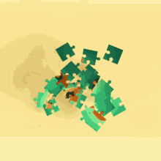
Venous and Lymphatic Medicine Today
Care is disjointed/fractionated
Incomplete

Slide 6
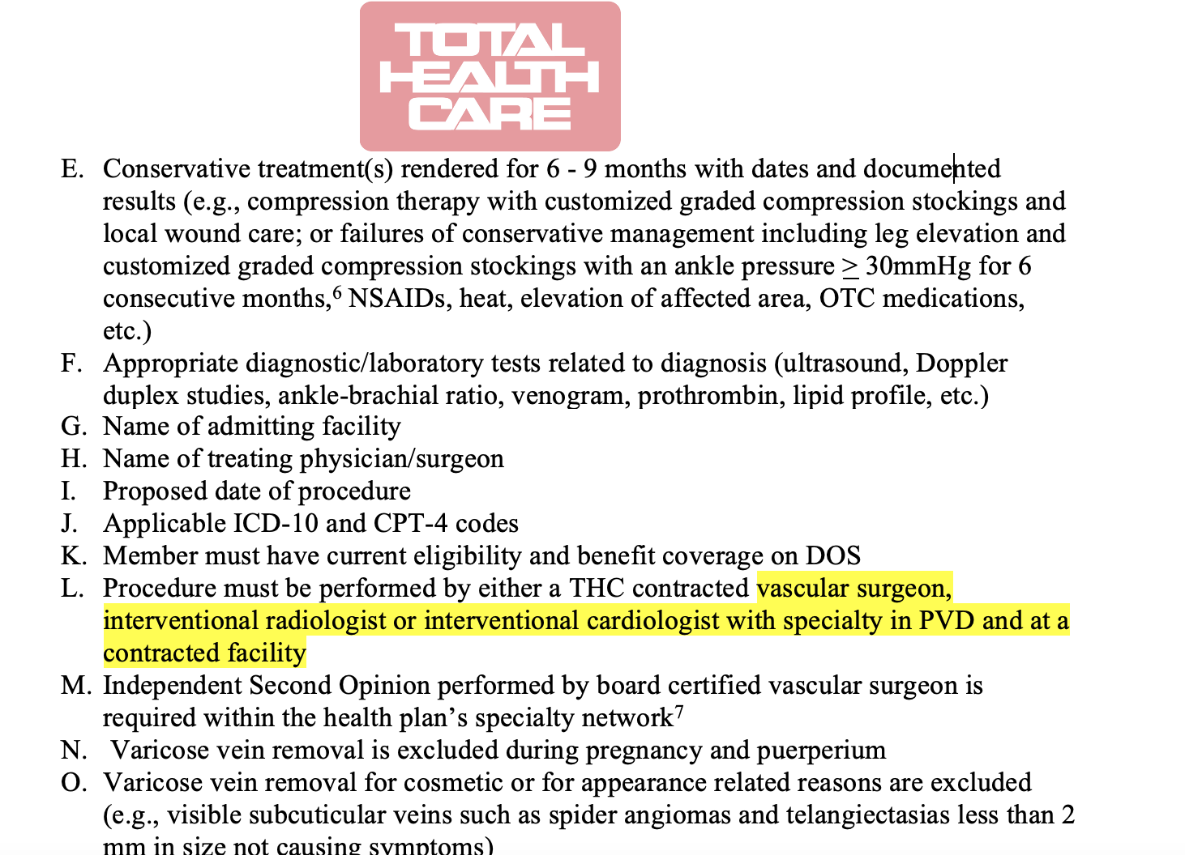
Who Decides Which Physician is Qualified?
Are they……?

Slide 7
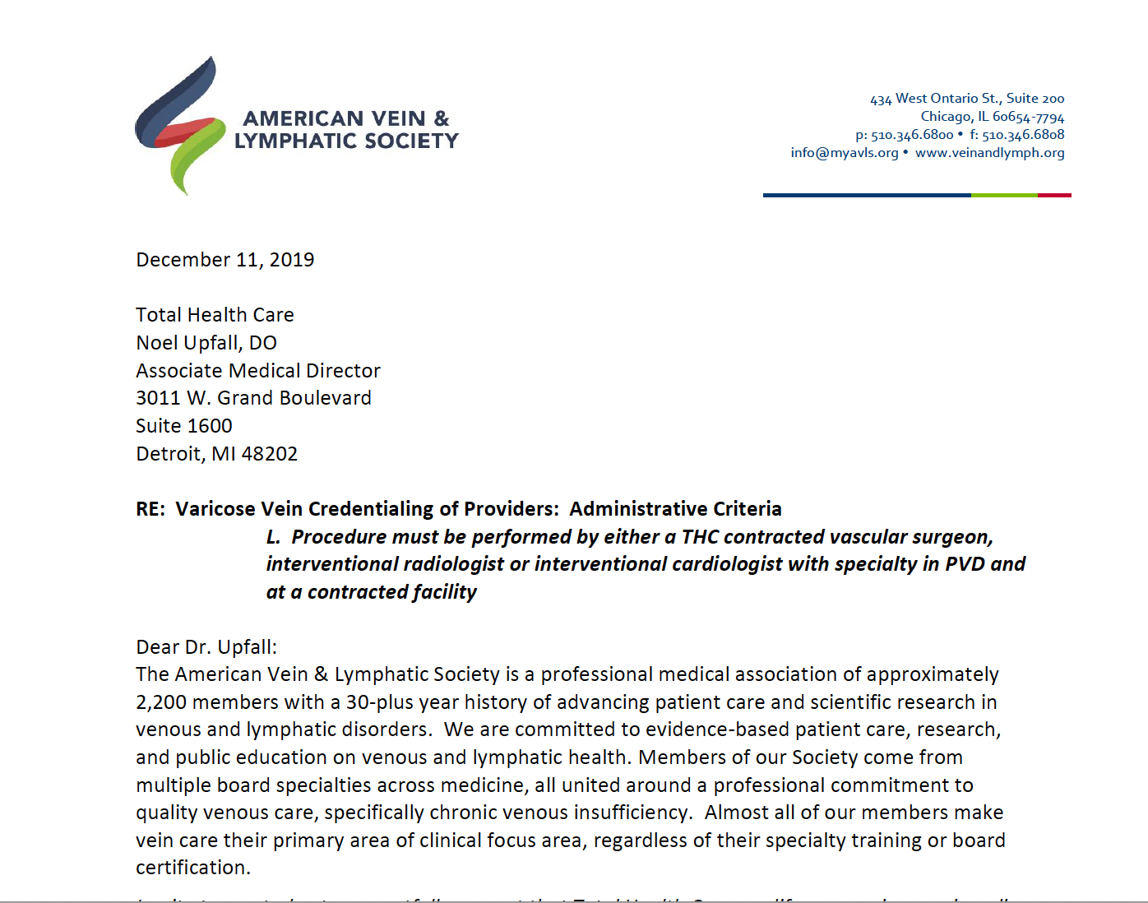
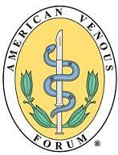
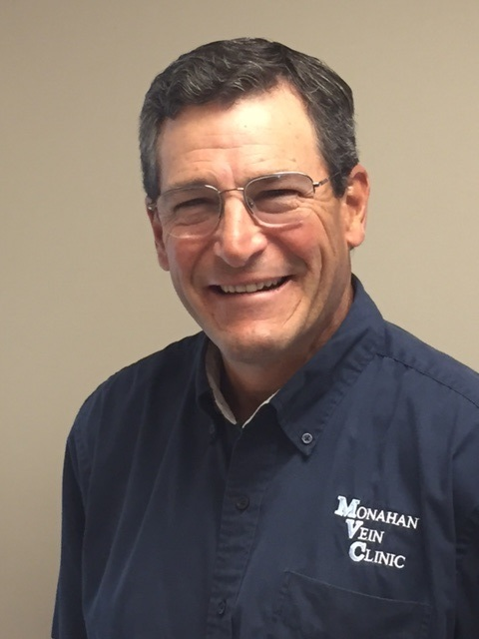
Who Decides Which Physician is Qualified?
Notes:
Dan Monahan

Slide 8
Chronic Venous Disease in the United States
25 million people in the US are estimated to have venous disease
6-7 million having advanced presentations, including venous leg ulceration (VLU).
VLU has been estimated to affect 500,000 to 600,000 people annually in the United States and is the most common leg ulcer treated in wound centers
Per the Association of American Medical Colleges (AAMC), the total
number of vascular surgeons in 2018 was 3,686
The number of interventional cardiologists was 3,840
The number of interventional radiologists was 3,415
That adds up to 11,000 providers (who primarily treat other conditions) to care for >25 million patients with venous and lymphatic disease, an obvious shortfall.

Slide 9
Chronic Venous Disease in the United States
A 2021 post-COVID Mayo Clinic study subsequently found that 1 in 3 physicians, APPs and nurses intend to reduce work hours due to challenges related to the COVID-19 pandemic.
One in 5 physicians and 2 in 5 nurses intend to leave medical practice altogether.
Also in 2021, Coleman et. al. surveyed members of the Society for Vascular Surgery (SVS) and found that their specialty was particularly vulnerable to physician burnout, with the second highest rate of burnout among all surgical specialties, leading to depression, high turnover, and early retirement.

Slide 10
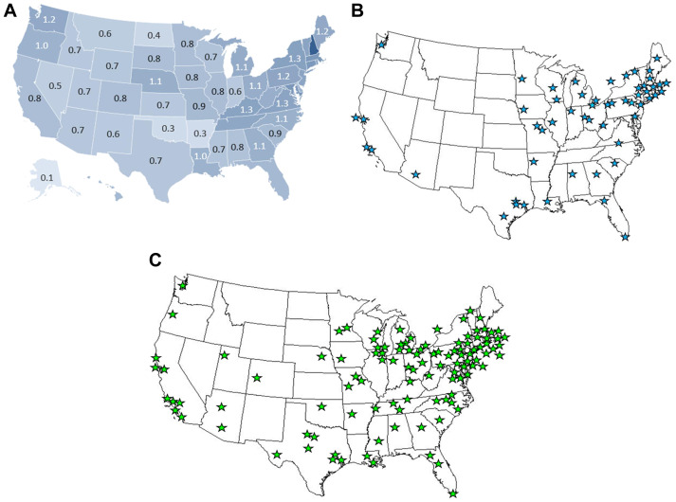
Vascular Surgeons in the United States
Fig 2. From Michael Makaroun’s 2022 SVS Presidential address: Geographic distribution of vascular surgeons A. Ratio of vascular surgeons per 100,000 population from the 2016 to 2017 ABMS board certification report (recommended is 1.4/100,000.) B. Geographic distribution of approved integrated vascular surgery residencies in June 2019. C. Geographic distribution of approved vascular surgery fellowships in June 2019.

Slide 11
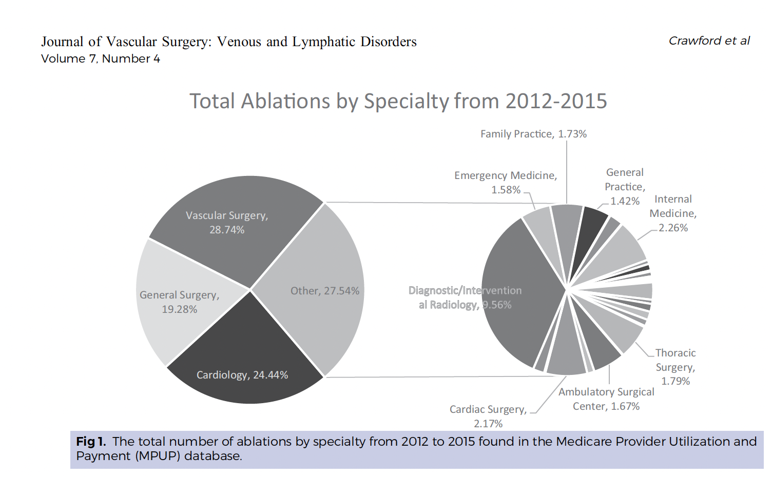
Background: VLM Practitioners Nationwide
Crawford et al Journal of Vascular Surgery: Venous and Lymphatic Disorders July 2019

Slide 12
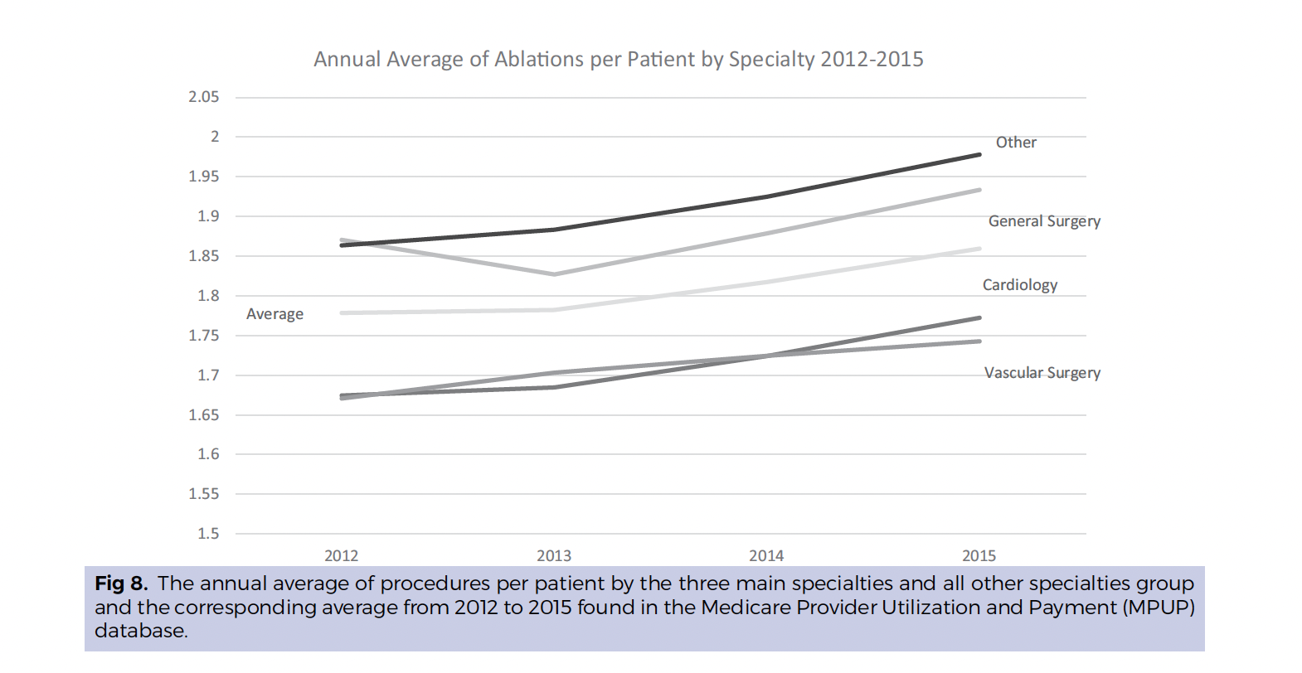
Background: VLM Practitioners Nationwide
Crawford et al Journal of Vascular Surgery: Venous and Lymphatic Disorders July 2019

Slide 13
Background: VLM Practitioners Nationwide
CONCLUSIONS:
Endovenous ablation reported in the MPUP database has had significant growth in numbers of providers, procedures, and treated patients.
The elimination of intentional or unintentional abuse needs to be a priority.
This data analysis can help providers and payers to establish better guidelines and governance over the appropriate use of endovenous ablation.
As our health care system shifts from a fee-for-service to a value-based system, and taxpayer-funded resources in Medicare beneficiaries become less available, it is important that practice trends be scrutinized using data-driven initiatives.
The ultimate goal is to have the right physician providing the right care to the right patient for the best results.
Crawford et al Journal of Vascular Surgery: Venous and Lymphatic Disorders July 2019

Slide 14
Background: VLM Practitioners Nationwide
Overutilization is a Multi-Disciplinary Challenge
From Mann et al. 2019, Significant physician practice variability in the utilization of endovenous thermal ablation in the 2017 Medicare population
"In our study, the top 10 use rates were found in physicians from vascular surgery, general surgery, internal medicine, family practice and interventional
radiology (Table VI), demonstrating that overuse is not a discipline-specific concern.”
Mann et al Journal of Vascular Surgery: Venous and Lymphatic Disorders November 2019

Slide 15
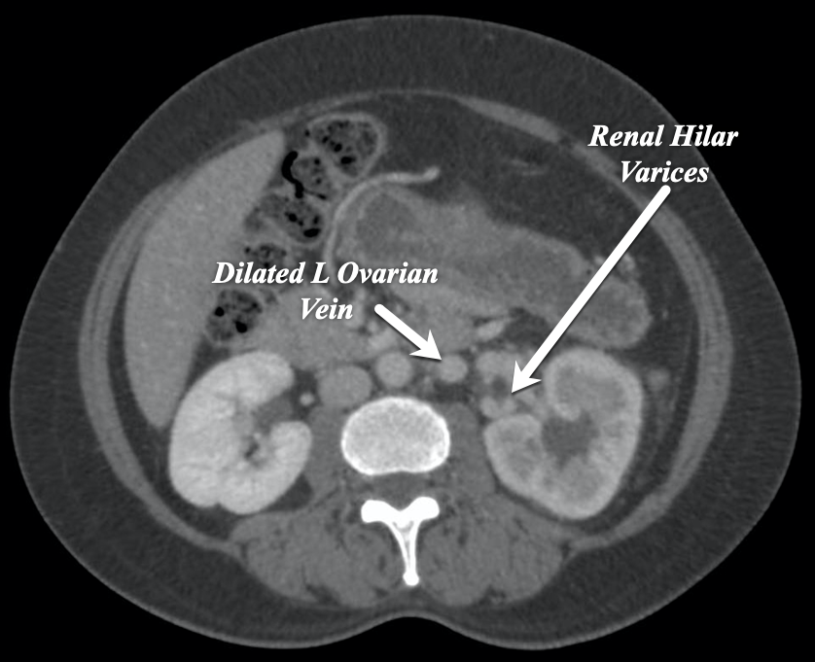
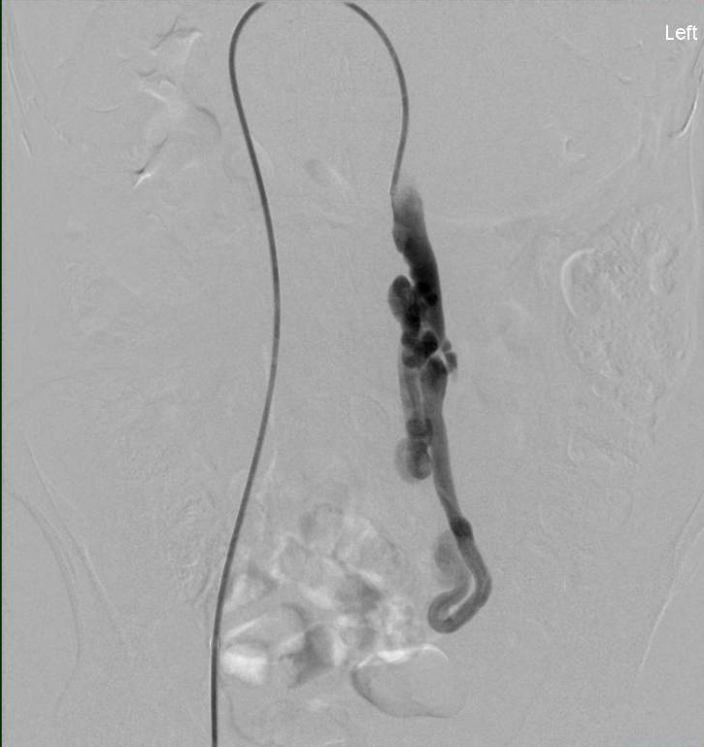
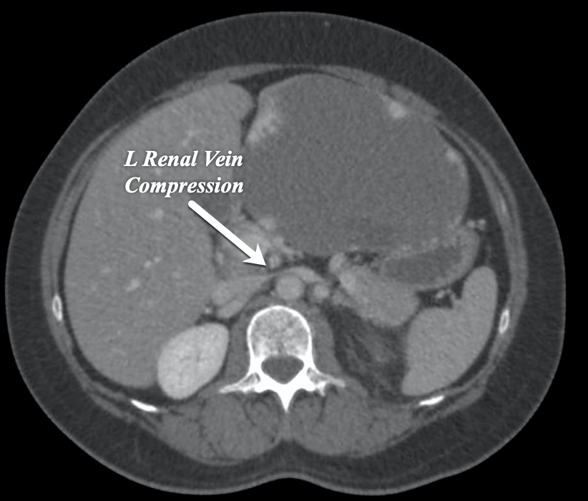
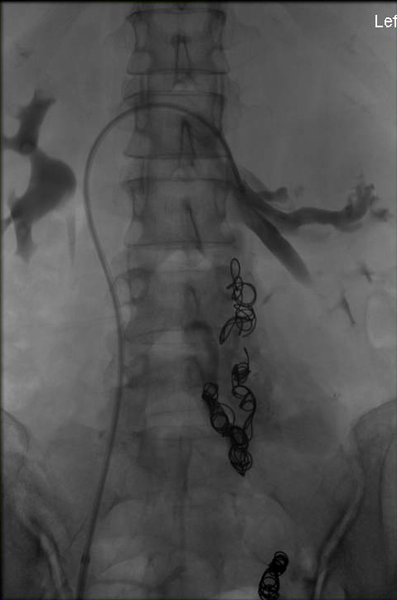
The Current Paradigm DOES NOT Serve Patients
40 yr-old female G3P2 female with 2 yr history of L flank and pelvic pain
Treatment by a “vascular specialist” with left ovarian vein embolization
Compensated converted to Uncompensated L Renal Vein Obstruction
Acute worsening of L flank pain and development of new hematuria
Venography – occlusion of L renal vein
Transrenal pressure gradient – 12 mm HG
Unacceptable Management Errors Are a Daily Occurrence in Venous Practice

Slide 16
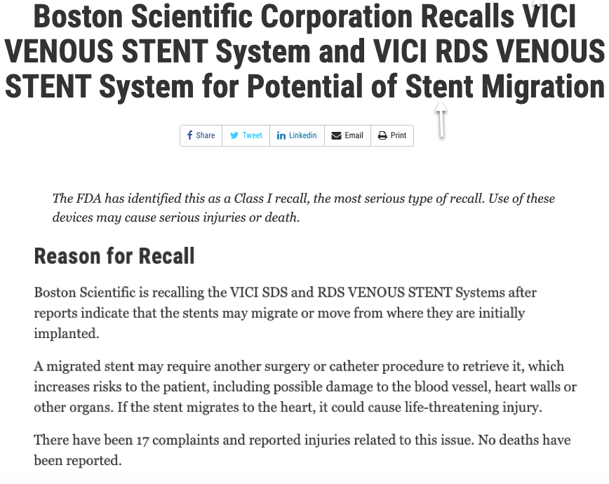

Slide 17
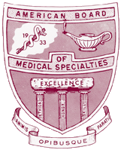
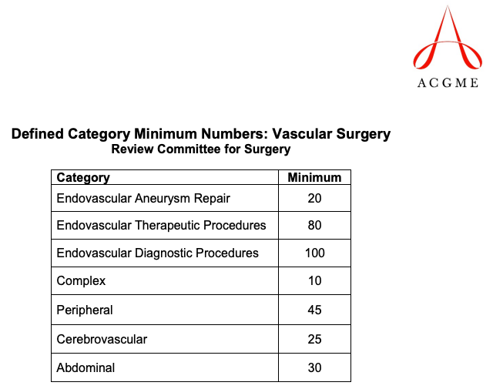
Venous & Lymphatic Medicine Training Vascular Surgery https://apps.acgme.org/ads/Public/Reports/Report/25
The training needed …must be distinct from that required for certification by current ABMS Member Boards so that it is not considered “included in established training programs” leading to defacto venous certification by these same Boards.
The training needed …must be distinct from that required for certification by current ABMS Member Boards so that it is not considered “included in established training programs” leading to defacto venous certification by these same Boards.
No Minimal Case Requirements For Venous Disease !!!

Slide 18
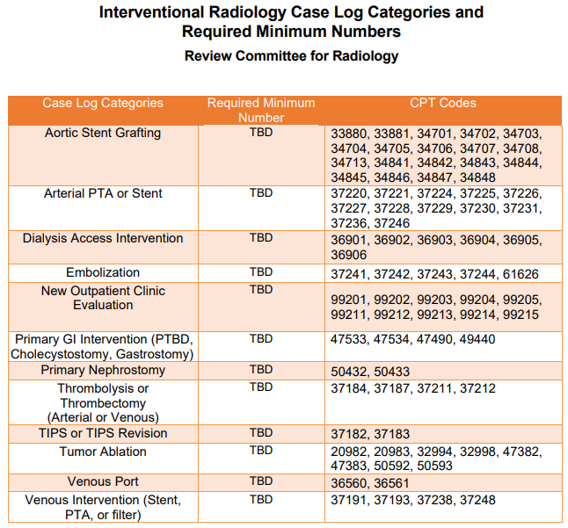
Venous & Lymphatic Medicine Training Interventional Radiology https://www.acgme.org/Portals/0/PFAssets/ProgramResources/IR_Case_Log_Categories.pdf?ver=2018-12-20-135106-953

Slide 19
The Knowledge Deficit is Apparent Lohr J, SVS 2009
Survey of 35 attendees at AVF fellows course
Anticipated 22% (10-50%) of practice in venous disease
Only 45% had vein clinic experience
Only 30% could adequately assess iliac vein stenosis
Only 10% could define pathologic reflux
Only 10% could accurately classify patients using CEAP
0% answered all anatomy questions correctly

Slide 20
Why All of This Matters to YOU!
Although there is a very large unserved patient population and despite claims by other boards, there is currently no dedicated Venous specialist. Effect on the patient.
Inadequate training leads to poor patient outcomes (supported by stent recall example) Effect of Industry.
Venous disease does not have a voice in reimbursement issues or standing as a specialty in the eyes of CMS. As a result, our reimbursement issues are usually grouped under other specialties such as vascular surgery, where most procedures are obviously not venous and the reimbursement issues may be different. Effect of VLM Physician.
Some insurance carriers attempt to limit access to vein care by restricitng reimbursement to designated specialists, despite the fact that there truly is no venous specialty. Effect on patient and VLM Physician.

Slide 21
VLM Physician of Today
On the job training
Weekend courses
Non-ACGME Accredited Fellowships
ABVLM Fellowships- Current Number of Programs 7:
CVR – 4 Programs
Jobst Vascular (Toledo, OH)
Prisma Health (Greenville, SC)
Harvard Medical (Boston, MA)
2 new sites have expressed interest
Anthem HealthCare (Charlotte, NC) – Erin Murphy
Univ S. Florida (Tampa, FL) – C. Pittman

Slide 22
VLM Physician of the Future
ABS
ABR
ABIM
ACGME Accredited VLM Fellowship Training
ABD
AFM
ABOG
ABEM
This is WHY the VLM Work Group came together
To SHAPE the future VLM Physician
What are our goals?

Slide 23
VLM Workgroup Mission Statement
Our mission is to define the specialty of “Venous and Lymphatic Medicine” in such a manner to allow properly trained physicians from the various specialties to practice evidence-based care.
The ultimate goal of this multispecialty collaboration is to compile the unique VLM perspectives of the various specialties into one standardize education, training, and certification pathway for all VLM physicians, leading to higher quality patient outcomes and satisfaction while limiting waste/abuse/misuse.

Slide 24
VLM Workgroup Evolution Brief Overview
Tom Granatir reached out to Zoe Deol to learn more about ABVLM
American Vein and Lymphatic Society (AVLS) assembled a Task Force
Official VLM Work Group Assembled
AVLS, AVF, SIR, SCAI, ADD, SVS, SVM
June 2021
August 2021
Many months/years of behind the scenes work prior to May 2021
May 2021
July 2021
September 2021
AVLS and AVF partner to form larger work group
Jeff Schoonover wrote to ABFM to ask for support for a VLM FPD.
Notes:
© Copyright PresentationGO.com – The free PowerPoint and Google Slides template library

Slide 25
Detailed VLM Historical Timeline
May 2021 Tom Granatir reached out to Zoe Deol to learn more about ABVLM
Also in May 2021, Jeff Schoonover wrote to ABFM to ask for support for a VLM FPD. ABFM later declined.
American Vein and Lymphatic Society (AVLS) assembled a Task Force of AVLS members to garner support from their own boards in a similar fashion.
August 2021, After Tom and Zoe’s initial phone call, a Zoom meeting was scheduled with Tom, Zoe, Mark Meissner, Jeff Schoonover, and Dean Bender from AVLS to discuss our intended path forward for VLM. Zoe and Jeff became co-chairs of this effort.
Zoe arranged meeting with Lynn Kirk from ACGME to discuss pathway to accreditation.
Official VLM Work Group then started to assemble with invitations extended to key members from Society of Interventional Radiology (SIR), Society for Vascular Surgery (SVS), Society for Vascular Medicine (SVM), Society for Cardiovascular Angiography and Interventions (SCAI), and American Society of Dermatologic Surgery (ASDS) as well as American Association of Dermatologists (AAD.) By
September 2021 the group was taking shape and first group Zoom meeting took place. Zoe reached out to Rabih Chaer, vascular surgeon from ABS to ask him to join the group as a liaison to ABS. Rabih accepted.
October 2021, first VLM Leadership Group Zoom meeting took place. Monthly meeting would occur through January 2022, when the group would also have representation from the American Board of Radiology (ABR)

Slide 26
Detailed VLM Historical Timeline
January 2022, the VLM Leadership Group gave the task of “Defining the VLM Physician” by revising/updating the current ABVLM Core documents and Program Requirements to the now assembled VLM Writing Group.
January 2022, Zoe and Mark speak with president of the American Board of Surgery (ABS), Jo Buyske, regarding the addition of a general surgeon board member to VLM Leadership Group, to represent those VLM surgeons who are not vascular surgeons (such as general and plastic surgeons.) John Mellinger’s name was brought up. No confirmation was obtained.
Also in January we had the addition of American Board of Radiology (ABR) to the Leadership Group with Brent Wegener (executive Director) and John Kauffman (treasurer)
February 2022 the AVF presented the various opinions on FPD vs VLM specialty at their annual congress: https://vimeo.com/682328708/34a97eb244
Zoe, Mark, and Neil supported VLM specialty recognition. BK supported FPD. Rabih made it clear that his position as a representative of ABS was to support a vascular surgery lead FPD. While Elna Masuda was originally invited to support FPD, she later switched and is now an active member of the VLM Work Group, nominated to represent AVF.
March/April 2022: SVS (BK Lal, Michael Dalsing, Ken Slaw) silently withdrew their support for the VLM Work Group to pursue Vascular Surgery FPD.

Slide 27
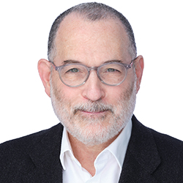
When The Tides Turned
Key Turning Point: ABMS Executive, Tom Granatir, reached out to me specifically to learn more about VLM and our current fellowship programs/board.
In our discussions, it became clear that:
ABMS is aware of the need to accommodate physicians who choose to transition from one specialty to another mid-career.
ABMS is looking at VLM as a possible window into the future for other similar multi-specialty groups interested in training/certification/recognition (Wound Care, Bariatric Medicine, etc…)
Tom Granatir, ABMS Senior Vice President, Policy and External Relations

Slide 28
VLM Workgroup Structure
VLM Subspecialty Leadership Group
VLM Subspecialty Advisory Council
(Society specific groups that update members on the VLM progress)
VLM Subspecialty ACGME
Writing Group

Slide 29
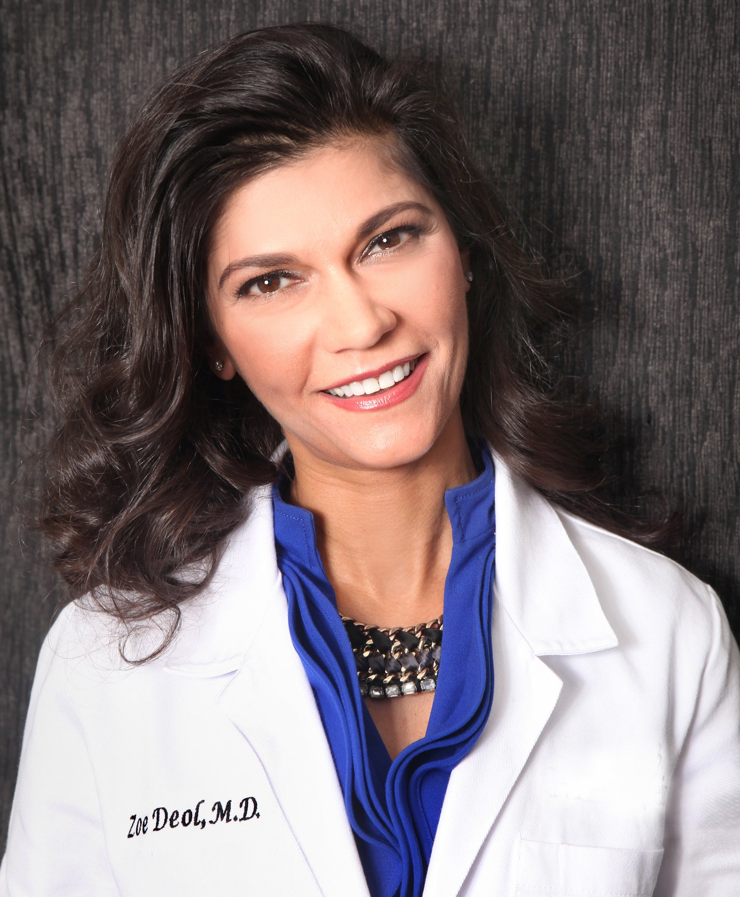
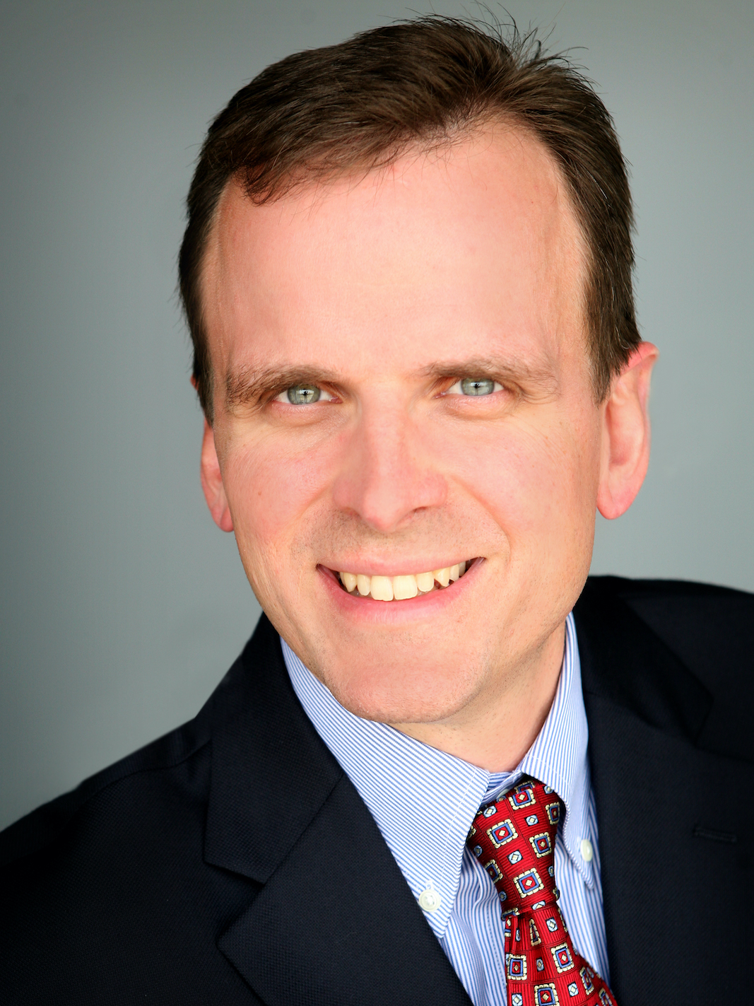
VLM Subspecialty Leadership Group Co-Chairs
Zoe Deol, MD, FACS
General Surgery
Jeff Schoonover, MD
Family Medicine

Slide 30
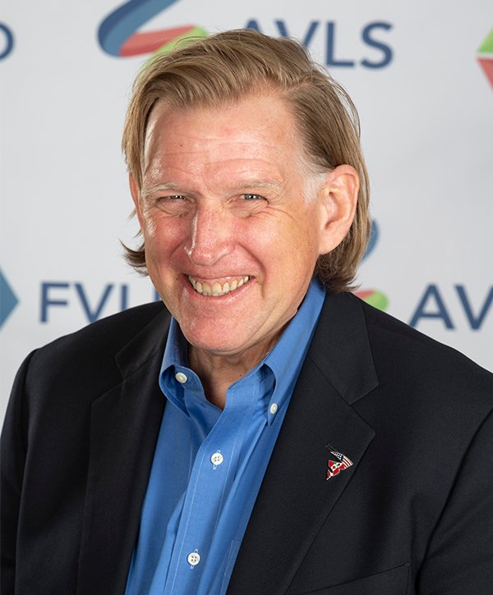
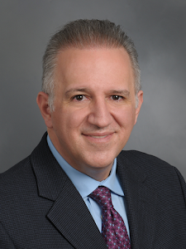
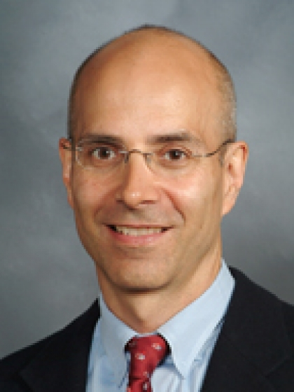
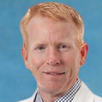
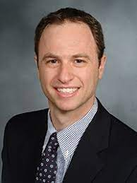
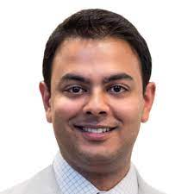
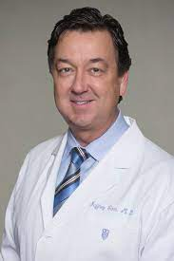
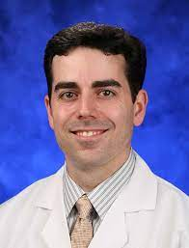
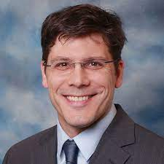
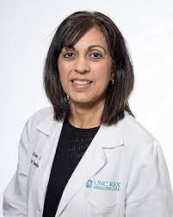
VLM Subspecialty Leadership Group Members
Mark Meissner, MD
AVLS
Tony Gasparis, MD
AVF
Neil Khilnani, MD
SIR
Bill Marston, MD
AVF
Ron Winokur, MD
SIR
Kush Desai, MD
SIR
Jeff Carr, MD
SCAI
Todd Cartee, MD
AAD
John Fish, MD
SVM
Suman Wasan, MD
SVM

Slide 31
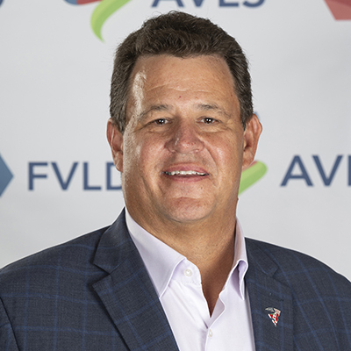
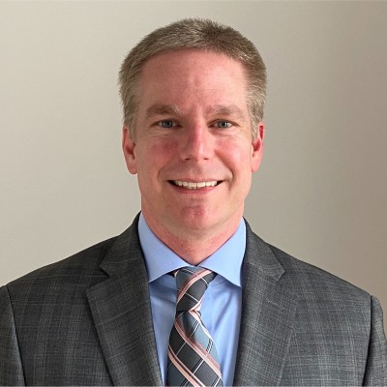
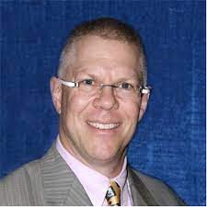
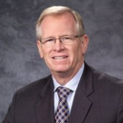
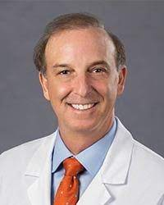
VLM Subspecialty Leadership Group Society Executives
Dean Bender, Executive Director AVLS
Keith Hume, Executive Director SIR
Chris Freed, CAE, Executive Director ABVLM
John Forbes Executive Director
AVF
Robert Kirsner, MD VP Elect of the AAD

Slide 32
ABMS Advisor to VLM Leadership Group
More than 25 years of experience working in health policy with a particular focus on quality and public accountability. He has worked in mental health policy for the state of Illinois; hospital policy for the American Hospital Association, the Health Research and Educational Trust, and the Joint Commission on Accreditation of Healthcare Organizations; long-term care policy for the Health and Medicine Policy Research Group; and in public health policy for Humana Inc., both in the United States and in the United Kingdom. He has served on the governing boards of the American Health Quality Association, the Institute for Safe Medication Practices, Bridges to Excellence, the National Association of Health Data Organizations, the Alliance to Make US Healthiest, and Henry Booth House, a service agency for poor residents of Chicago. Mr. Granatir also has been an examiner for the Malcolm Baldrige National Quality Award Program, a member of the Health Policy Roundtable of the Michael Reese Health Trust, and served on the Roundtable on Ethnic and Racial Disparities of the Institute of Medicine.
Tom Granatir, ABMS Senior Vice President, Policy and External Relations

Slide 33
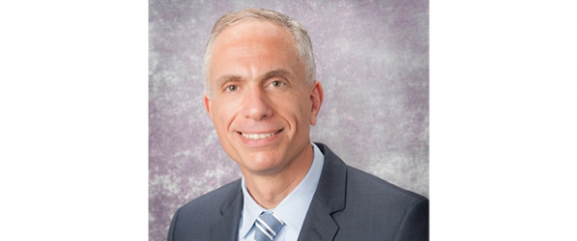
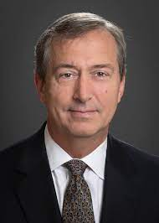
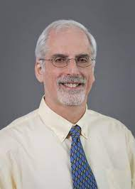
Primary Board Advisors to VLM Leadership Group
Dr. Rabih Chaer joined the VSB in 2019 after being elected to represent the Society for Vascular Surgery (SVS). He serves as the committee chair for the VSB's Focused Practice Designation Committee, and is a member of the QE Committee, VSITE Committee and Education and Research Committee. He is also a councilor of the American Board of Surgery.
Dr. Wagner has served on the ABR Board since 2011 and is currently a member of the ABR’s Board of Governors. He is a former staff member of the Armed Forces Institute of Pathology (AFIP) and current visiting lecturer for the American College of Radiology’s (ACR’s) American Institute for Radiologic Pathology (AIRP). He is on the editorial board of Radio Graphics, offering his expertise in genitourinary imaging.
Dr. Wagner also serves on the Professionalism Committee for the Radiological Society of North America (RSNA) and is a member of the Commission on Leadership and Practice Development for the ACR.
Rabih Chaer, MD
ABS/ VSB
Brent Wagner, MD, MBA
ABR Executive Director
Dr. Kaufman has had pivotal roles in the transition of interventional radiology from a subspecialty of diagnostic radiology to a primary specialty of the ABR and in the development of the IR residency. He has been an ABR volunteer since 1997.
Authored or co-authored more than 200 publications including five textbooks. He is co-editor of the quarterly review journal Techniques in Vascular and Interventional Radiology and Associate Editor for the journal CardioVascular and Interventional Radiology.
John Kaufman, MD
ABR Treasurer

Slide 34
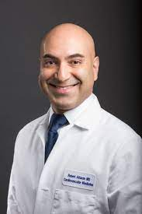
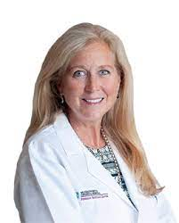
VLM Subspecialty ACGME Writing Group
Member of the Division of Cardiovascular and Interventional Radiology at the New York Presbyterian Hospital-Weill Cornell Medical Center since 1992. He is an Associate Professor of Clinical Radiology at the Weill Medical College of Cornell University. Past President of resident of AVLS, and President of the Intersocietal Accreditation Commission-Vein Center, and Venous Service Line representative to the Executive Committee the Society of Interventional Radiology. Board of Directors of ABVLM.
Professor of surgery who specializes in vascular surgery at the University of Washington School of Medicine. Past president of the American Venous Forum, and current President of the American Vein and Lymphatic Society. Board of Directors of AVLS.
Board certified general surgeon and fellowship trained bariatric surgeon with additional certification from the ABVLM in venous and lymphatic medicine. Board of Directors for AVLS. Current Regional Medical Director, Research Committee member, and ABVLM Associate Fellowship Program Director at Center for Vein Restoration.
Zoe Deol, MD
Mark Meissner, MD
Neil Khilnani, MD
Division of Vascular and Endovascular Surgery at Massachusetts General Hospital, the medical director of the Venous Program and director of the Vein Care Center. She is an assistant professor of Surgery at Harvard Medical School. She has also been elected to the executive boards of the New England Society of Vascular Surgery, the American College of Phlebology and the American Venous Forum, and served as treasurer of the American Board of Venous and Lymphatic Medicine.
Dr. Jeffery Schoonover, MD, RVT, RPVI, FAAFP is a Diplomate of the American Board of Venous and Lymphatic Medicine and is committed to varicose vein disease treatment.
In 2008, Dr. Jeff Schoonover was one of the first physicians in the nation to be certified by the American Board of Venous and Lymphatic Medicine. Since 2007, he has been a member of the American Venous and Lymphatic Society and in 2019 joined the Foundation for Venous and Lymphatic Disease board.
Director of the Interventional Cardiology Fellowship Program and the Endovascular Fellowship Training Program at Yale. He serves on the American College of Cardiology's National Cardiovascular Data Registry, Research and Publications Committee. He is a member of the Vascular Disease Council of the Society for Cardiac Angiography and Intervention.
Jeff Schoonover, MD
Family Medicine
Robert Attaran, MD
Julianne
Stoughton, MD

Slide 35
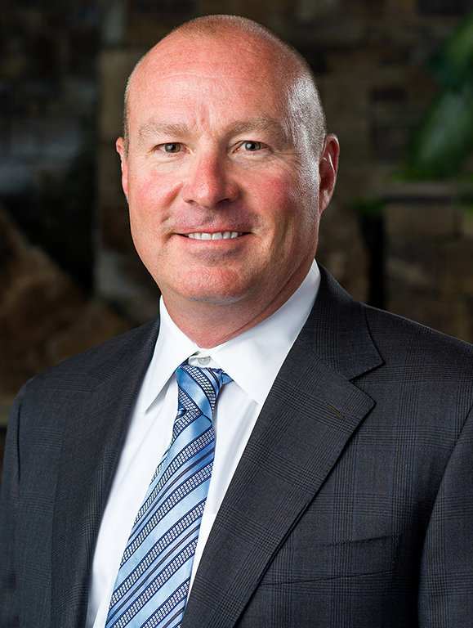
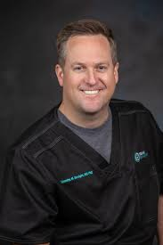
VLM Subspecialty ACGME Writing Group
Board-certified general surgeon in Bend, Oregon with a dedicated interest in the management of venous disease. He was an investigator in several major varicose vein clinical trials, and, as a result, he goes beyond his day to day clinical duties to help advance the care of venous patients. Most noteworthy of these clinical trials is the VeClose trial. He was also an investigator, along in the Vanish-1-trial, a randomized trial evaluating the efficacy of Varithena in the treatment of venous insufficiency
Associate Professor of Radiology Director, Venous Interventions at Thomas Jefferson University in PA. focuses clinical care on the treatment of venous disease with special attention to varicose veins, pelvic congestion syndrome, DVT and PE. Interested in improving the patient experience in interventional radiology by using research to advance medical knowledge and administrative skills to advance the role of IR in medical care. Focused on expanding the role of simulation in IR education.
Penn State Health Dermatologist with fellowship training in Mohs micrographic surgeon, and special interests in veinous disease. Dr. Cartee then sought dedicated post-fellowship training in phlebology. He is certified by the American Board of Dermatology and his expertise in treating varicose veins and venous insufficiency has been recognized through certification by the American Board of Venous and Lymphatic Medicine.
Andrew Jones, MD
Todd Cartee, MD
Ron Winokur, MD
Served as Chief Medical Officer for the largest and most advanced medical center, medical readiness platform, and academic referral center in the Department of Defense: including a level 1 Trauma Center, six outpatient primary care clinics, the Center for the Intrepid, a Warrior Transition Battalion, Army Troop Command, and an Air Force Medical Group. Served as the principal medical advisor to the Commander at the executive level responsible for the delivery and quality of healthcare in a multi-service market with a staff of 9,000 employees and over $800 million dollars in budget execution. Served as Chief of the Medical Staff for over 1900 privileged healthcare providers. Served on the Board of Directors for medical education, providing executive oversight, coordination, and support for 38 graduate medical programs and 22 allied health programs with over 690 residents and fellows.
Interventional Radiologist and Associate Professor of Radiology, Surgery, and Medicine at Northwestern University. Chair of the Society of Interventional Radiology’s venous clinical specialty council, and reviewer for several journals, including Circulation, Journal of the American College of Cardiology, Journal of Vascular Surgery: Venous and Lymphatic Disorders, and as a top reviewer for Journal of Vascular and Interventional Radiology.
Clinical Professor of Medicine and Adjunct Professor of Surgery at University of North Carolina, Chapel Hill and Vascular medicine specialist at UNC Health. Principal investigator in several research projects regarding chronic venous disease, pulmonary embolism and deep-vein thrombosis. Member of the American Board of Venous and Lymphatic Medicine.
Kush Desai, MD
Suman Wasan, MD
Timothy Straight,MD

Slide 36
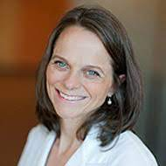
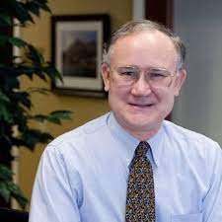
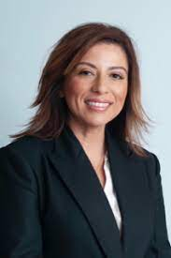
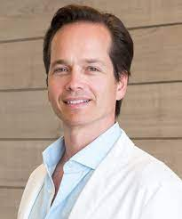
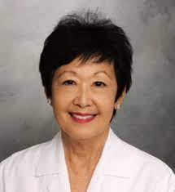
VLM Subspecialty ACGME Writing Group
Board certified internal medicine with specialty certification in vascular medicine. He practices at the renowned Jobst Vascular Institute in Toledo, Ohio where he serves as the Director of Vascular Medicine and participates in local and national research and educations projects related to venous disease.
Practices vascular surgery, treating both venous and arterial disorders in Bellevue, Kirkland, and Issaquah, Washington. Principal Investigator on 19 different clinical trials (varicose veins, surgical hemostasis, wound healing, and novel anticoagulants for thromboembolism). She has been author or co-author on multiple book chapters and peer-reviewed journal articles. President-elect of AVLS.
Certified by the American Board of Surgery in 1985 and he was one of the first group of diplomates of the new American Board of Venous and Lymphatic Medicine in 2008. He was an advisor to the Curriculum Task Force of the American Board of Venous and Lymphatic Medicine. He is a Fellow of the American College of Surgeons and Fellow of the American Vein and Lymphatic Society. Active Member of the American Venous Forum, and a member of the Society for Vascular Ultrasound.
Kathleen
Gibson, MD
Stephen
Daugherty, MD
John Fish, MD
Clinical Associate Professor of Radiology and Division Chief of Vascular Interventional Radiology at University of North Carolina at Chapel Hill. Specialist in women’s and venous interventional procedures and serves as Chair of the Society of Interventional Radiology’s Women’s Health Service Line.
Dr. Elna Masuda has a passion for the treatment of both arterial and venous disease. She has provided care at Straub for more than 20 years, during which time she helped to facilitate the development of a vascular department that provides care in both arterial and venous diagnosis and intervention. She serves on both SVS and AVF
Dr. Jay Granzow is an internationally renowned lymphedema and lipedema surgeon, scholar and educator. He founded the Granzow Lymphedema & Lipedema Center to provide comprehensive and effective treatment for lymphedema and lipedema patients from all over the world.
Gloria Salazar, MD
Elna Masuda, MD
Jay Granzow, MD

Slide 37
VLM Physician of Today
ABVLM Fellowships- How do we currently recruit fellows?
The following slide is a brief interview (conducted on 12-31-21) with a future ABVLM fellow (class of 2023.)

Slide 39
Goals of the VLM Workgroup
Define the specialty through the ABMS
Standardize education/training, inclusive of components contributed from various other specialties currently practicing (i.e. dermatology etc…)
Grow ACGME accredited fellowship programs
Widen access to quality care for all venous and lymphatic patients
Improve patient outcomes with broader scope and breadth of care for VLM patients
Inform – 3rd party payers of the validity of this specialty and stop the ad hoc policy exclusions for certain specialties
Advocate – for a voice at CMS which is distinctly different from other specialties, and serving a distinctly different patient population
Reasonable Timeline: No more than 5 years to complete these goals, with 20 or more VLM Fellowship Programs to be established by then

Slide 40
Road Map to VLM
Define training
Define specialty
Which comes first?

Slide 41
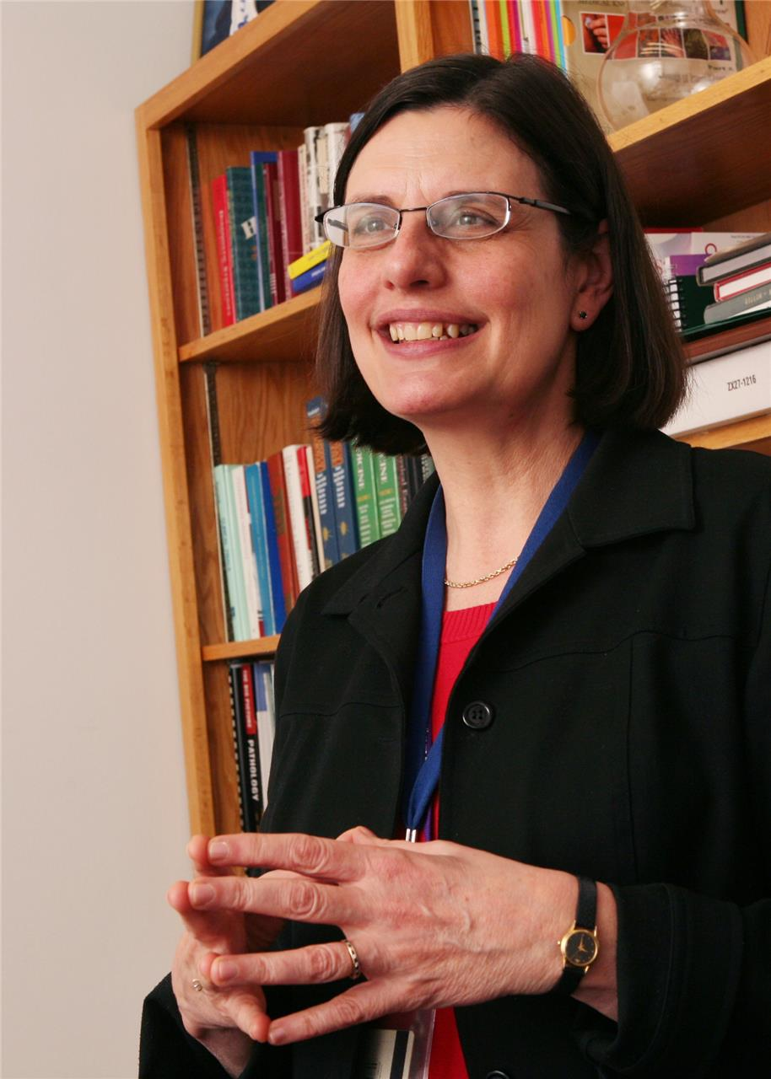
ACGME Advisors to VLM Workgroup
Lynne M. Kirk, MD, MACP joined the ACGME as its Chief Accreditation Officer. Dr. Kirk leads the ACGME’s specialty and subspecialty Review and Recognition Committee activities relating to the review of residency and fellowship programs. She monitors and manages the development, revision, and dissemination of national accreditation standards for residency programs; lead continuous quality improvement of the accreditation process; and advises the committees on policies and procedures to ensure fair and equitable evaluation of programs.
From my discussion with Dr. Kirk, ACGME applications are given much more consideration if they have already received ABMS specialty recognition. Without ABMS recognition, the application would have difficulty moving forward. Case in point would be the recent SVM application to ACGME for fellowship training in Vascular Medicine (a primarily arterial medical specialty.). This application was denied, and lack of ABMS recognition was significant reason.
Lynne Kirk, MD, MACP,
Chief Accreditation Officer ACGME

Slide 42
ABMS Options Considered
New ABMS Board “American Board of Interdisciplinary Medicine”: Proposed by Zoe Deol
Most challenging option (No new ABMS board since 1991)
Could solve problem of future interdisciplinary training programs (bariatric medicine, etc…)
Conjoint Board: Proposed by Carrie Raddabaugh from ABMS
Primary Board that is established and functions under the joint sponsorship of no less than two (2) Primary Boards. A Conjoint Board’s members are appointed by some or all of the respective sponsors and approved by the sponsoring Primary Boards, its policies are determined in conformity with the policies jointly established by the sponsoring boards, and it may or may not be financially independent.
Co-Sponsorship Model for VLM Recognition: Proposed by Tom Granatir
Currently most functional model with precedent set by Sleep Medicine
Pathway has been outlined by precedent
Next step will be to determine costs to two primary boards (ABS and ABR)
Focused Practice Designation (FPD) Model: Proposed by BK Lal (Vascular Surgery driven through AVF/SVS)
Limitations-
No ABMS board certification given (experience-based certificate)
Current FPD model requires individual sponsoring board to bear administrative expenses and does not easily accommodate cross-specialty collaboration
Lack of impact on VLM training program creation and overall ACGME approval for fellowship application

Slide 43
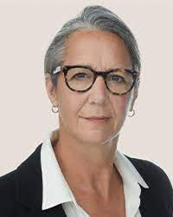
ABMS Options Considered
Focused Practice Designation (FPD) Model: Proposed by BK Lal
Recent meeting with Jo Buyske, MD President and CEO of the American Board of Surgery- ‘The ABS will not be proceeding with any further FPDs for any of the surgical specialties, including VSB. The ones they currently have are low yield, expensive, and labor intensive.’

Slide 44
VLM Conjoint Board Option
A “Conjoint Board” is a body established under the joint sponsorship of not less than two (2) Primary Boards, although national specialty organizations may be included as sponsors. The purpose of a Conjoint Board is to set training standards and evaluate the qualifications of individual candidates in an area of specialty practice common to the sponsoring groups.
A Conjoint Board resembles a Primary Board in that it is separately incorporated and has similar responsibility for determination of requirements for certification, accepting candidates for certification, administering examinations, and issuing certificates.
A Conjoint Board differs from a Primary Board in that it is established and functions under the joint sponsorship of not less than two (2) Primary Boards. A Conjoint Board’s members are appointed by some or all of the respective sponsors and approved by the sponsoring Primary Boards, its policies are determined in conformity with the policies jointly established by the sponsoring boards, and it may or may not be financially independent.
Applicants for certification by a Conjoint Board must complete satisfactorily a preliminary training program acceptable to at least one (1) of the sponsoring boards and to the Conjoint Board in order to be considered for examination by the Conjoint Board.

Slide 45
Intersocietal Participation
ABS
AVLS Counsel
AVF Counsel
ABR
SIR Counsel
ABIM
ABD
SCAI Counsel
SVM Counsel
ADD Counsel

Slide 46
Co-Sponsorship Subspecialty Model
ABS
ABFM
ABIM
ABR
ABOG
ABEM
ABD
ABA
Administrative Board
Co-Sponsoring Board
Qualifying Boards

Slide 47
ABMS Co-Sponsorship Subspecialty Model
The Administrative Board
American Board of Surgery
Lead Sponsoring Board - Coordinates the governing process among co-sponsors.
Responsible for assessment and scoring of primary certifying examinations in the subspecialty.
Administers continuing certification exams for its own diplomates, diplomates of qualifying boards, and sometimes diplomates from co-sponsoring boards if they choose its assessment.
Issues certificates to its own diplomates and to diplomates of qualifying boards. Co-sponsoring boards issue certificates to their own diplomates.

Slide 48
ABMS Co-Sponsorship Subspecialty Model
The Administrative Board
American Board of Surgery VLM Subspecialty Board Members:
Ultimate goal would be to have a balance between General Surgery, Vascular Surgery, and Plastic Surgery board members
Selection process at the discretion of ABS

Slide 49
ABMS Co-Sponsorship Subspecialty Model
The Co-Sponsoring Board
American Board of Radiology
Proportionally represented partner with the ABS Administrative Board.
Validates whether its diplomates are eligible for certification with the Administrative Board
Takes responsibility for the assessment and scoring of the continuing certification examination for diplomates who choose to be assessed by their own Co-Sponsoring Board
Issues the initial and continuing certification certificates to their own diplomates and diplomates of Qualifying Boards.

Slide 50
ABMS Co-Sponsorship Subspecialty Model
The Co-Sponsoring Board
American Board of Radiology VLM Subspecialty Board Members:
Selection process at the discretion of ABR

Slide 51
ABMS Co-Sponsorship Subspecialty Model
The Qualifying Boards
Qualifying Boards
Not co-sponsoring boards, but its diplomates may apply for a Subspecialty Certificate through another ABMS Member Board and participate in that board’s continuing certification program.
These qualifying boards would include: Dermatology, Internal Medicine, Family Medicine, Emergency Medicine, GYN and anesthesiology.

Slide 52
ABMS Co-Sponsorship Subspecialty Model
Proposed Qualifying VLM Boards
American Board of Internal Medicine VLM Subspecialty Board Members
American Board of Family Medicine VLM Subspecialty Board Members
American Board of Dermatology VLM Subspecialty Board Members
American Board of Emergency Medicine VLM Subspecialty Board Members
American Board of Obstetrics and Gynecology VLM Subspecialty Board Members
American Board of Anesthesiology VLM Subspecialty Board Members
Selection process at the discretion of each individual Board

Slide 53
Comparisons Made Between ABMS and AOA Existing Models of Specialty Recognition
In an attempt to better understand the various current ABMS options, and brainstorm about potential new options, we took a look at the AOA process.

Slide 54
American Board of Medical Specialties (24)
Dermatology
OB-GYN
Ophthalmology
Otolaryngology
Orthopedic Surgery
Pediatrics
Psychiatry & Neurology
Anesthesiology
Plastic Surgery
Physical Medicine & Rehabilitation
Radiology
Urology
Internal Medicine
Pathology
Surgery
Neurosurgery
Colon & Rectal Surgery
Preventative Medicine
Family Medicine
Allergy & Immunology
Nuclear Medicine
Thoracic Surgery
Emergency Medicine
Medical Genetics & Genomics

Slide 55
AOA Board of Medical Specialties (18)
https://certification.osteopathic.org
Dermatology
OB-GYN
Ophthalmology & Otolaryngology
Emergency Medicine
Orthopedic Surgery
Pediatrics
Psychiatry & Neurology
Anesthesiology
Neuromusculoskeletal
Medicine
Radiology
Nuclear Medicine
Internal Medicine
Pathology
Surgery
Preventative Medicine
Family Medicine
Physical Medicine & Rehabilitation
Proctology

Slide 56
AOA Conjoint Examination Committees (9)
Addiction Medicine
(FM/IM/Neuro-psych)
Allergy & Immunology
(IM/Peds)
Correctional Medicine
(FM/IM/PM)
Dermatopathology
(Derm/Path)
Hospice & Palliative Medicine
(FM/IM/EM/Neuro-psych/PM&R)
Undersea & Hyperbaric Medicine
(FM/IM/EM/PM)
Sports Medicine
FM/IM/Peds/Neuro-musculoskel/PM&R)
Sleep Medicine
(FM/IM/Opth-Otolary/PM&R)
Pain Medicine
FM/IM/Neuro-musculoskel/PM&R)
https://certification.osteopathic.org/conjoint-examination-committees/
Existing AOA Conjoint Examination Committees have 2-6 participating boards on each committee
When added to the other 18 primary boards, there are a total of 28 AOA specialties

Slide 57
Evolution of AOA Conjoint Committees
In 1993 the American Osteopathic Academy of Sports Medicine submitted an application to form an independent board of sports medicine.
The AOA executive director, in conjunction with the BOS, was instead directed to promote the formation of conjoint examinations in areas of overlapping specialties (Resolution 56 [M/1994]—Proposed Mechanism for Creation of a Conjoint Examination in Sports Medicine).
These examinations allow for the cooperation of all appropriate specialty boards, the general adaptability of the profession, and the ongoing relevance of the certification process to osteopathic physicians.
The Standards Review Committee reviews conjoint examinations at the last meeting of each evaluation cycle. Diplomates from participating member boards are eligible to sit for conjoint examinations.
Two more conjoint committees followed sports medicine: addiction medicine and dermatopathology
Osteopathic Specialty Board Certification. Armando F. Ramirez and Elaine C. Bell Journal of Osteopathic Medicine https://doi.org/10.7556/jaoa.2007.107.3.117

Slide 58
Evolution of AOA Conjoint Committees
In 2006, two more conjoint examinations were proposed.
The first of these was in response to the American Board of Hospice and Palliative Medicine and the American Board of Sleep Medicine standalone certification examination programs being absorbed by member boards of the ABMS.^{20,21}
As a result of this change, only physicians holding one of the following credentials would be eligible to take the examination in hospice and palliative medicine or in sleep medicine through ABMS member boards: (1) allopathic specialty board certification through an ABMS member board, (2) ACGME training, or (3) both.
Osteopathic leadership quickly responded to this change by proposing the creation of conjoint osteopathic examinations in these two specialty areas.
In February 2007, the AOA Board of Trustees subsequently approved CAQ in hospice and palliative medicine as well as CAQ in sleep medicine with conjoint committees comprised of the following three osteopathic specialty boards
5 Conjoint specialties created in 14-year time span with 4 more to follow
Osteopathic Specialty Board Certification. Armando F. Ramirez and Elaine C. Bell Journal of Osteopathic Medicine https://doi.org/10.7556/jaoa.2007.107.3.117

Slide 59
Evolution of ABMS Conjoint Board
Michael Nelson, MD, PhD, the executive of the American Board of Allergy and Immunology gave some insight into the creation of the only current ABMS conjoint specialty board. He explained that the path to a conjoint board was a long one. He shared reading materials from a book about the founding of the board.
In the history of ABAI forming an autonomous board was a motivating force from the 1940s when the discipline emerged. But it took a long time to recognize that two co-equal pathways could exist.
35 years of turf wars
1 year (with leadership of Dr. William Willard) to create Conjoint board, officially proposed July 11, 1970 with first “O’Hare Meeting”, and officially adopted 17 months later on December 11, 1971
Another board – Emergency Medicine – at one time contemplated a conjoint board model, but eventually decided that the practice and training were distinct from other specialties, and instead created an independent primary board.

Slide 60
American Academy of Hospice and Palliative Medicine
A fellowship in the subspecialty of hospice and palliative medicine is mandatory in order to sit for the American Board of Medical Specialties (ABMS) or American Osteopathic Association (AOA) board certification examinations.
In AOA, exam is contained under one roof as a single Conjoint Board Exam.
In ABMS, they are independent, differing fellowships, each given under the specific specialty.
Hospice and palliative medicine fellowship programs are available for:
allopathic and osteopathic professionals in 10 different primary boards:
anesthesiology
emergency medicine
family medicine
internal medicine
obstetrics and gynecology
pediatrics
physical medicine and rehabilitation
psychiatry and neurology
surgery
and radiology
Some programs include an additional track in pediatrics, geriatrics, research or public health.
181 ACGME accredited Hospice and Palliative Care Fellowship programs nationwide.
http://aahpm.org/career/clinical-training

Slide 61
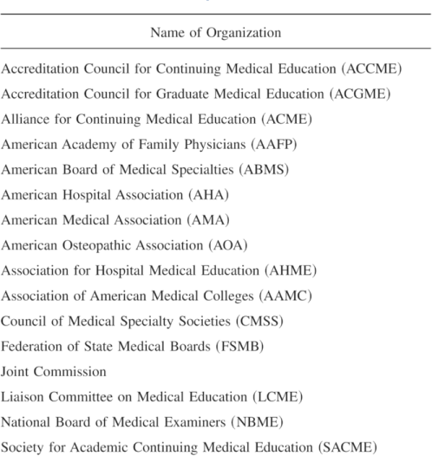
Conjoint Committee on Continuing Medical Education
Since 2002, the Conjoint Committee on Continuing Medical Education, an ad hoc group of representatives from 16 major stakeholder organizations (see Table 1), has endeavored to integrate performance improvement into CME, ensure the content validity of CME and evaluate the effectiveness of CME in improving the quality of care.
Continuing Medical Education, Professional Development, and Requirements for Medical Licensure: A White Paper of the Conjoint Committee on Continuing Medical Education Stephen H. Miller, M.D., M.P.H., F.A.C.S.;et. al. Journal of Medical Regulation (2008) 94 (2): 8–11.https://doi.org/10.30770/2572-1852-94.2.8

Slide 62
ABMS Board Options Update
Is there a fourth option?

Slide 63
American Board of Interdisciplinary Medicine
Made up of representatives from each of the established boards (“United Nations”), this new board would be able to certify any and all emerging specialties that include practicing physicians from two or more primary specialty backgrounds.
The Primary Goal for creating this new board would be to standardize education, training, and practice in multidisciplinary specialties (VLM, Wound Care, Bariatric Medicine, etc…), thus improving quality of care and patient outcomes.
Secondary goal would be to remove roadblocks to the advancement of medicine that arise from perceived specialty turf wars.

Slide 64
American Board of Medical Specialties (25?)
Dermatology
OB-GYN
Ophthalmology
Otolaryngology
Orthopedic Surgery
Pediatrics
Psychiatry & Neurology
Anesthesiology
Plastic Surgery
Physical Medicine & Rehabilitation
Radiology
Urology
Internal Medicine
Pathology
Surgery
Neurosurgery
Colon & Rectal Surgery
Preventative Medicine
Family Medicine
Allergy & Immunology
Nuclear Medicine
Thoracic Surgery
Emergency Medicine
Medical Genetics & Genomics
Interdisciplinary Medicine
?

Slide 65
This IS Achievable
Richard E. Hawkins, MD - President and CEO of the American Board of Medical Specialties met with us.
Interested in moving ABMS into the future
Recognizes “practice plasticity” and is open to new ideas in medical sub/specialization
Looking at VLM Work Group to set an example of a potential path forward.
Made investment in our group by offering to gather the following boards to discuss our project: ABS, ABR, ABIM, ABD

Slide 66
Plasticity Matrix
The Plasticity Matrix model projects physician supply and physician visit utilization before reconciling the two.
The model uses American Medical Association (AMA) Masterfile data, American Board of Medical Specialty (ABMS) certification data, and resident supply data to determine physician supply, and it uses MEPS (Medical Expenditure Panel Survey) data and community-level demographic and economic information to generate community-level forecasts of physician visit utilization for each Clinical Service Area (CSA.)

Slide 67
The Contribution of “Plasticity” to Modeling How a Community’s Need for Health Care Services Can Be Met by Different Configurations of Physicians Holmes, George M.; Morrison, Marisa; Pathman, Donald E.; Fraher, Erin Academic Medicine88(12):1877-1882, December 2013.
doi: 10.1097/ACM.0000000000000026
Plasticity Matrix Demonstrating That Multiple Specialties Care for the Same Clinical Service Areas, Within Certain Bounds, as Shown by Number and Percentage of Visits Within Four Clinical Service Areas by Specialty, 2009*
Notes:
Table 1 provides a simplified version of this matrix with only five physician specialties and four CSAs. In this simplified model, cardiologists provide 34% of all patient visits for circulatory conditions in a single year (in this case, 2009), and a small percentage (< 4%) combined for patient visits related to neoplasms, respiratory illnesses, and pregnancy/childbirth. Family physicians provide 38% of circulatory visits but also provide the majority of visits for respiratory conditions compared with cardiologists, dermatologists, obstetricians–gynecologists, and internists. In other words, among a subset of CSAs—specifically, neoplasms, circulatory-related conditions, respiratory conditions, and pregnancy/childbirth visits—cardiologists provide care for essentially only circulatory visits, whereas family physicians provide the bulk of their visits in circulatory and respiratory conditions.
Thus, family physicians are more plastic—that is, they can provide visits for two of the illustrated conditions, whereas cardiologists focus on only one CSA

Slide 68
Dodging the Roadblocks
Difficulty in developing an adequate number of fellowships.
We intend to address this by bring the fellowship programs back under the AVLS umbrella and hiring a full-time graduate medical education coordinator charged with overseeing the current fellowship and developing new fellowships. Part of the current problem is relying on a group of overstretched volunteers to achieve this.
Resistance from those already in practice who fear being disenfranchised:
A grandfather pathway for current VLM specialists.
Resistance from other specialties such as vascular surgery
We will continue to be inclusive/inviting to the vascular societies (AVF/SVS), and all other societies who have an interest, for their advice and participation

Slide 70
This IS Achievable
Group of forward thinking, multispecialty physicians working together for a common goal: the welfare of the VLM patient
Group of society and medical board executives providing support and guidance
Publications
Society presentations
The time is right……NOW!

Slide 71
VLM Work Group Publications
“The United State of Venous and Lymphatic Medicine – Uniting the Specialties to Form a More Perfect Union” – Zoe Deol. Provisionally accepted by JVS.
SCAI (Society for Cardiovascular Angiography and Interventions) Newsletter – VLM Work Group Update – Robert Attaran and Jeff Carr finalizing article.
VLM Core Documents – Original ABVLM document revised by VLM Writing Group. Document being finalized by Neil Khilnani and Suman Wasan. Target Publication Submission: Fall of 2022
VLM Program Requirements - Original ABVLM document being revised by VLM Writing Group. Target Publication Submission: First quarter of 2023

Slide 72
2022 Society Meetings
Society Meetings at which VLM Leadership Group Members May Present:
AVF- February 23-26 in Orlando (VLM Presentation Completed)
SVS – June 15-18 Boston, MA
SIR – June 11-16 Boston, MA
AVLS Executive Leadership July 22-24 (VLM Presentation Scheduled)
SCAI – May 19-22 Atlanta, GA
SVM – September 29-October 1 Denver, CO
AVLS Congress – October 13-16 New Orleans, LA

Slide 73
VLM Subspecialty Work Group Thank You!
Getting all these specialties together is like “herding cats…”
What a beautiful cat it has become!

